Slide 1
Working with AI tools
How do I brief an AI tool and check what it returns?
Applied AI and Automation | Session 3 of 12
KLAi Professional Learning | Jotham Martin Wambi
Notes:
Welcome back. Last session you tested your own task text and saw where an assistant fails. Today you write the instruction that prevents those failures, run it, and check the result against the source. One rule first, until Session 4: no names, phone numbers, prices or contracts go into any tool.
The question for today is this: How do I brief an AI tool and check what it returns? Keep it in mind. At the end of the session we come back to it and see how much more you can say.

Slide 2



Today in one view: what you will leave with
By the end of today you will have
A clear view of the kinds of AI assistant and the five account questions to ask before company data goes in
A reusable seven-part brief for your own task, with one example of a good answer
One result from that brief, checked against its source
Notes:
Here is what you leave with today. A clear view of the kinds of assistant, and the five questions to ask about an account before company data goes in. A reusable brief with seven parts, including one example of a good answer. And one result from that brief that you have checked against its source.
The brief is the lasting asset, so we spend most of today on it.

Slide 3
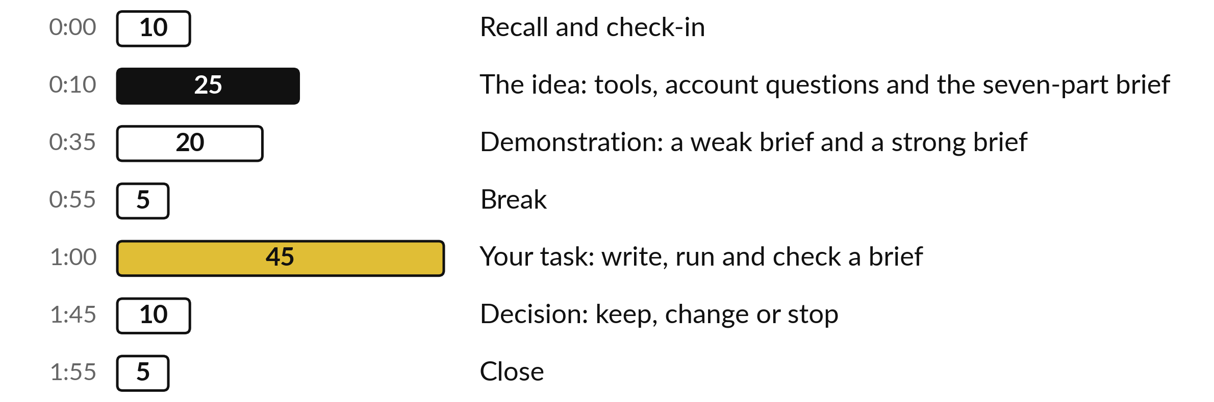
Your two hours: most of
the time is your own work
45 of the 120 minutes are yours: write a brief, run it, check it.
Notes:
Three parts matter most today. I spend twenty-five minutes on the idea, and twenty minutes on a demonstration with a weak brief and a strong one. Then forty-five minutes are yours: you write the brief, run it on a sample, and check what comes back. If we run long, I shorten my talking.

Slide 4

Three questions from last time
1. How does a language model produce an answer?
2. Name the three reliability tests and the failure each one catches.
3. How do you check an old fact?
Answer aloud first. Then we check together.
Notes:
Three quick questions from Session 2. Answer aloud first, and then we check together. It is a warm-up to bring last time back.
Question one. How does a language model produce an answer? Take a moment.
A good answer is this. It predicts the next likely word from patterns learned in training, and it is tuned to be helpful. Unless search, files or memory are on, nothing in the process checks a fact.
Question two. Name the three reliability tests and the failure each one catches. Say it to yourself first.
A good answer is this. Ask twice: answers that change. Remove a fact: invented facts. Ask for the source: made-up sources, and every claim, whatever the tone.
Question three. How do you check an old fact? Think about your own task as you answer.
A good answer is this. Ask the tool the date its knowledge ends and check anything time sensitive against a current source.
If an answer was missing, your own task card or last workbook page has it. Now to today.

Slide 5




Words we use today
Word | What it means
Prompt | Anything you type into an assistant.
Brief | A prompt written once, in seven parts, and reused.
Assistant | The product you talk to. The model is the engine inside it.
Source | The original document or sheet a figure or claim comes from.
Notes:
Four words for today. I give the plain meaning of each, and we use every one of them before the end of the session.
Prompt. Anything you type into an assistant.
Brief. A prompt written once, in seven parts, and reused.
Assistant. The product you talk to. The model is the engine inside it.
Source. The original document or sheet a figure or claim comes from.

Slide 6
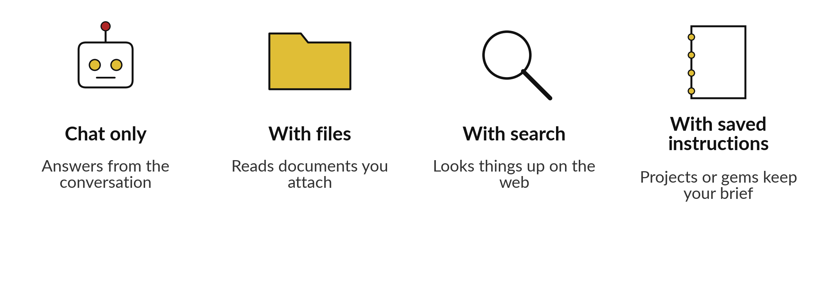
Assistants differ in what
they can see and remember
Until Session 4: no names, phone numbers, prices or contracts in a tool.
Notes:
First, three words I will use all day. A prompt is anything you type. A brief is a prompt written once, in seven parts, and reused. The assistant is the product you talk to, and the model is the engine inside it. Assistants come in four common kinds.
Chat only, which answers from the conversation. With files, which reads documents you attach. With search, which can look things up on the web. And with saved instructions, which some tools call projects or gems. Check which your account offers. Until Session 4, put no names, phone numbers, prices or contracts into any tool.

Slide 7



Same five questions, any product
Does the tool train on what I paste?
How long does it keep my chats?
Who in my company can see my chats?
Is this a work account or a personal one?
Does my company rule allow this tool?
Notes:
Whatever product you use, whether Copilot, ChatGPT, Claude, Gemini or another, the five questions are the same. The answers depend on the plan more than the brand. A free personal account, a business plan and an enterprise plan can answer differently, and the answers change over time. So read your own settings and terms.
Does it train on what you paste?
How long does it keep chats?
Who in your company can see them?
Is it a work account or a personal one?
Does your company rule allow it?
At Nile Valley Foods, handbook clause 4.4 says customer data, price lists and contracts may not go into a public AI tool without the Managing Director approving it in writing.

Slide 8







A brief has seven parts, written once and reused
Part | What you write | Nile Valley Foods example
1 Goal | What should exist, and who reads it | Monday sales email for directors
2 Context | Who we are and what readers need | Food distributor in Jinja
3 Inputs | Exactly what I give you | Two weeks of sales rows
4 Constraints | Length, tone, what to leave out | 150 words, no invented reasons
5 Format | The shape of the answer, with one example of a good answer | Subject, three bullets, a table, one sample bullet
6 My check | What I will compare | Table total against the sheet
7 If unsure | The words to write when unsure | Write NOT IN DATA
The examples are for the Monday sales email. The demonstration brief uses the same seven parts for the market notes, so the two differ on purpose.
Notes:
This is the structure of your brief, taken from your template. Goal, context, inputs, constraints, format, how I will check, and what to say when unsure. Notice part five: it holds one example of a good answer, and we look at that next. Part seven matters most. If you tell the tool what to write when it does not know, such as NOT IN DATA, you cut down the invented answers you saw last session.
Write the brief once, check it, and reuse it. Next time you change only the inputs.

Slide 9
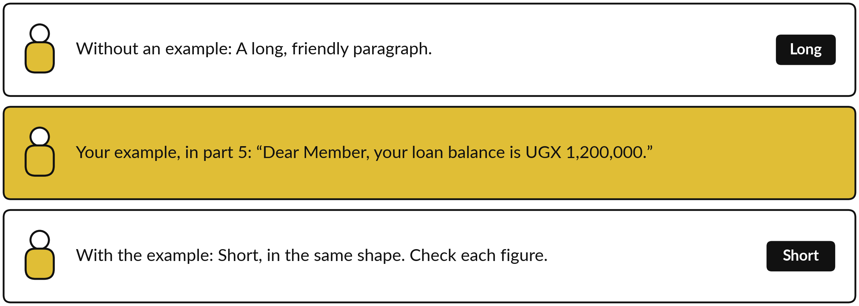
A SACCO reply: one example teaches the shape
One or two examples: few-shot. Use invented ones.
Notes:
Words describe a shape badly, and an example shows it at once. So in part five, the format, you add one example of a good answer. Here a SACCO wants replies to members who ask for a loan balance. Without an example, the tool tends to write a long, friendly paragraph in its own style.
With one short example, it usually copies the shape, the length and the order. Giving one or two examples is called few-shot. Two cautions. Use invented or cleaned examples, with no real member data. And the tool copies mistakes too, so check every figure it writes.

Slide 10
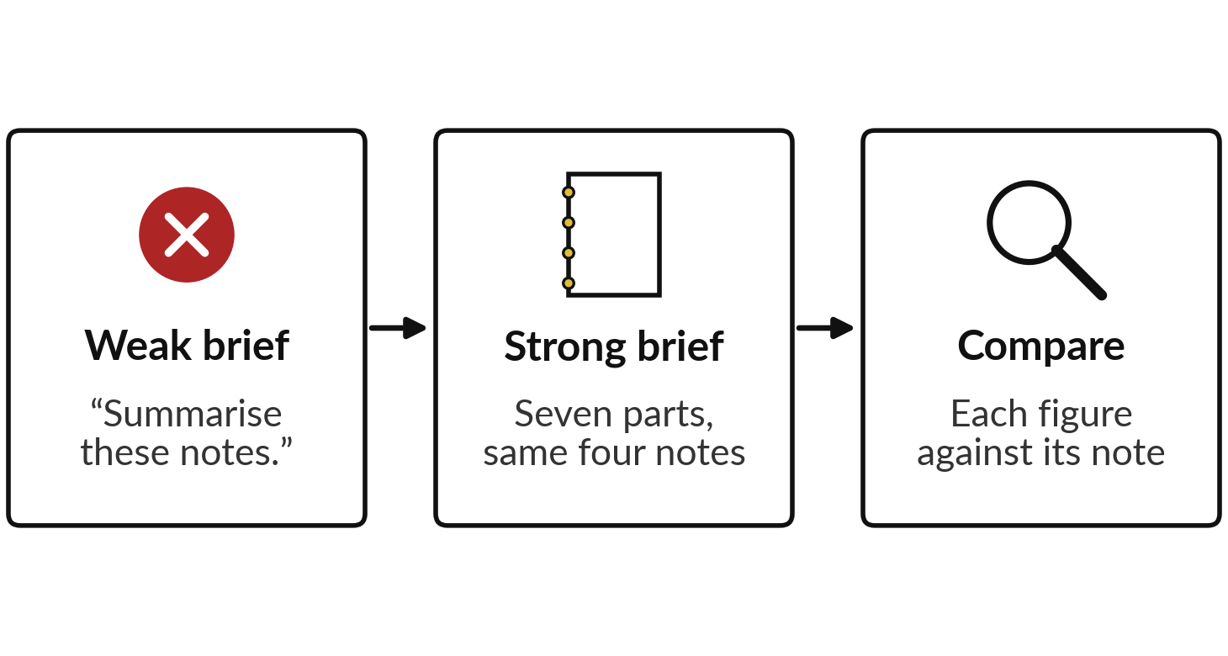
Demonstration: the market notes,
with a weak brief and a strong one
I will show
Watch for
Does the one-page briefing show where sources disagree?
Does every figure match a note?
Does it add reasons the notes do not give?
Notes:
Now the demonstration. I give the assistant four fictional market notes about staple prices in Eastern Uganda. First a weak brief, one line: summarise these notes. Then the strong brief with all seven parts, which you see written out on the sheet after this, asking for a one-page briefing.
We run both live, and you compare the two results against the notes. Watch whether the briefing shows where the notes disagree, whether every figure matches a note, and whether it adds reasons the notes never gave.

Slide 11







The strong brief for the market notes
Part | What the strong brief says
1 Goal | One-page briefing for the directors on staple prices in Eastern Uganda, week 41.
2 Context | Food distributor in Jinja. Directors must see where sources disagree.
3 Inputs | Only market notes 1 to 4, attached and fictional. No other knowledge.
4 Constraints | Under 250 words. No reasons unless a note gives them. Note number by each figure.
5 Format | Five bullets, then a table. Example: Rice, UGX 2,900 a kg (note 3).
6 How I will check | I will find every figure in its note and list where two notes differ.
7 If unsure | If notes disagree or a figure is missing, show both with notes, or write NOT IN DATA.
Notes:
Here is the strong brief in full. Part one names the goal and the reader. Part two says who we are and what the directors need. Part three limits the inputs to the four notes. Part four sets length and tone, and forbids invented reasons. Part five gives the format and one example bullet, which is the few-shot example.
Part six says how I will check. Part seven says what to write when unsure, and it shows both figures when notes disagree. The weak brief was one line, and it left every one of those decisions to the tool.

Slide 12
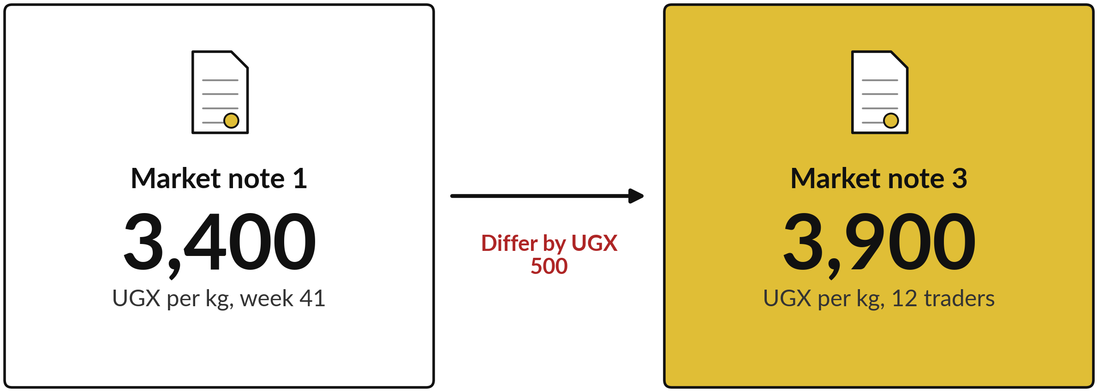
Where the notes disagree: maize flour in week 41
A good briefing states both figures, names both notes and says what to check.
Notes:
Now the checking, after the demonstration. These notes are fictional and illustrative. Note one gives maize flour at three thousand four hundred shillings a kilogram for week forty-one. Note three gives three thousand nine hundred for the same product, region and week. That is a difference of five hundred shillings, and note three says it used only twelve traders.
A good briefing states both numbers, names both notes, and says what to check. An average of the two would hide the problem. Check the live result for what the assistant did.

Slide 13
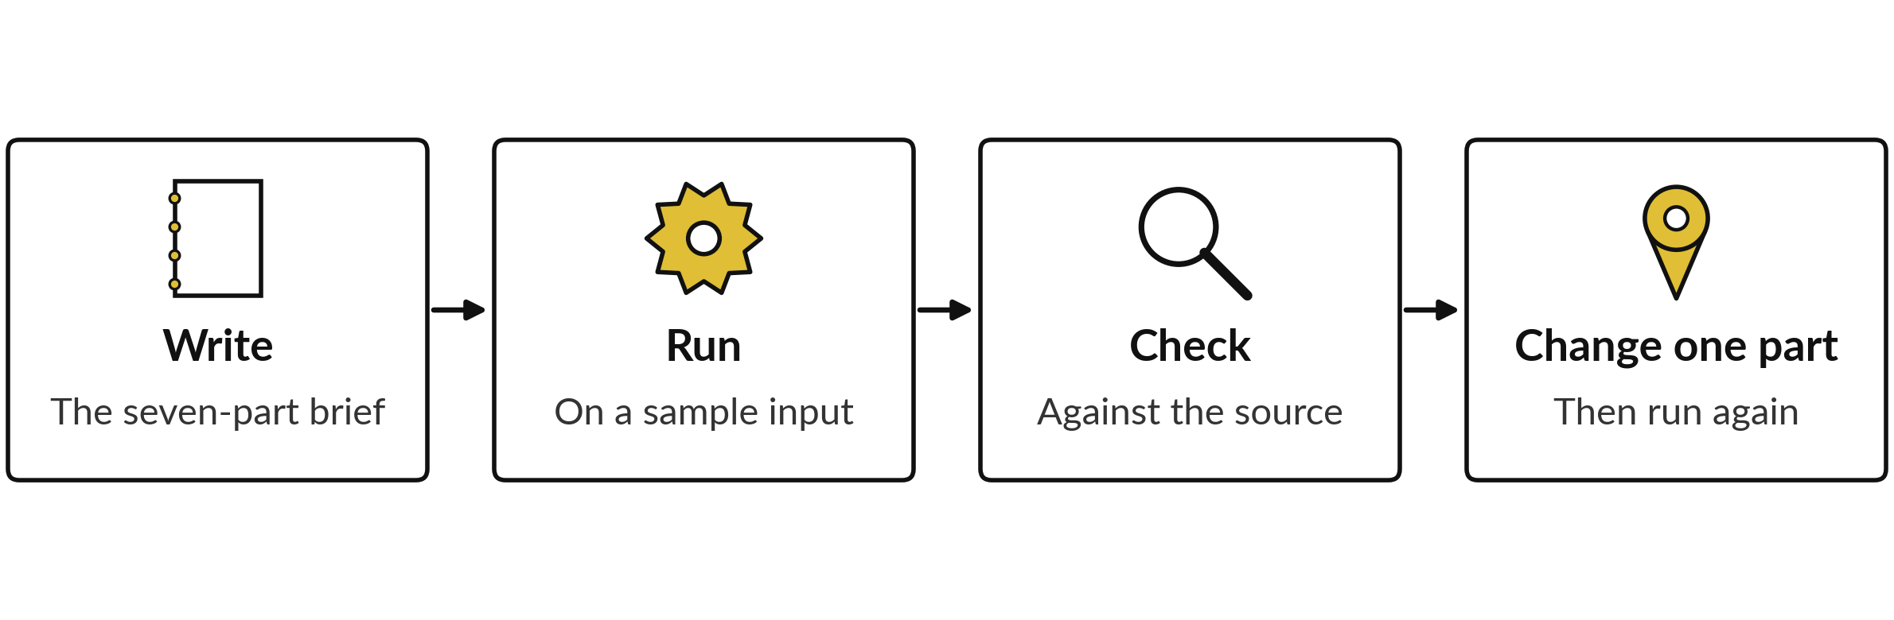
Run the brief, check it,
change one thing, run it again
Check every figure, name and date against the source. Add a rule for every mistake.
Notes:
Briefing is a loop. Write the brief, run it on a sample, and check the result against the source. Then change one part of the brief and run it again. Change one thing at a time so you know what helped. The check has a routine. Find each figure in the source.
Add up totals and recompute changes yourself. Check names, dates and quotes word for word. And look for what is missing as well as what is wrong. Every mistake you find becomes a rule in the brief. When the result is right, save that version and reuse it.

Slide 14
A complete brief, ready to
paste: the Monday sales email
1 Goal
Monday email to directors on last week’s sales.
2 Context
Food distributor in Jinja. Directors read it.
3 Inputs
weekly_sales sheet, two weeks. Use only these.
4 Constraints
Under 150 words. No reasons the sheet lacks.
5 Format
Subject, 3 bullets, table. Example: Mbale up 7.6%.
6 How I check
I compare the table total with the sheet.
7 If unsure
Write NOT IN DATA by the figure. Do not estimate.
Notes:
Here is a complete brief for the Monday sales email, with all seven parts, written the way you will write yours. You can paste it into a tool as it stands. Read it from the top. The goal names the reader. The inputs are limited to one sheet.
The constraints stop invented reasons. The format includes one example bullet. Part six is what I will check, and part seven is what to write when unsure. Yours will be about this long, and no longer. Now you write your own.

Slide 15
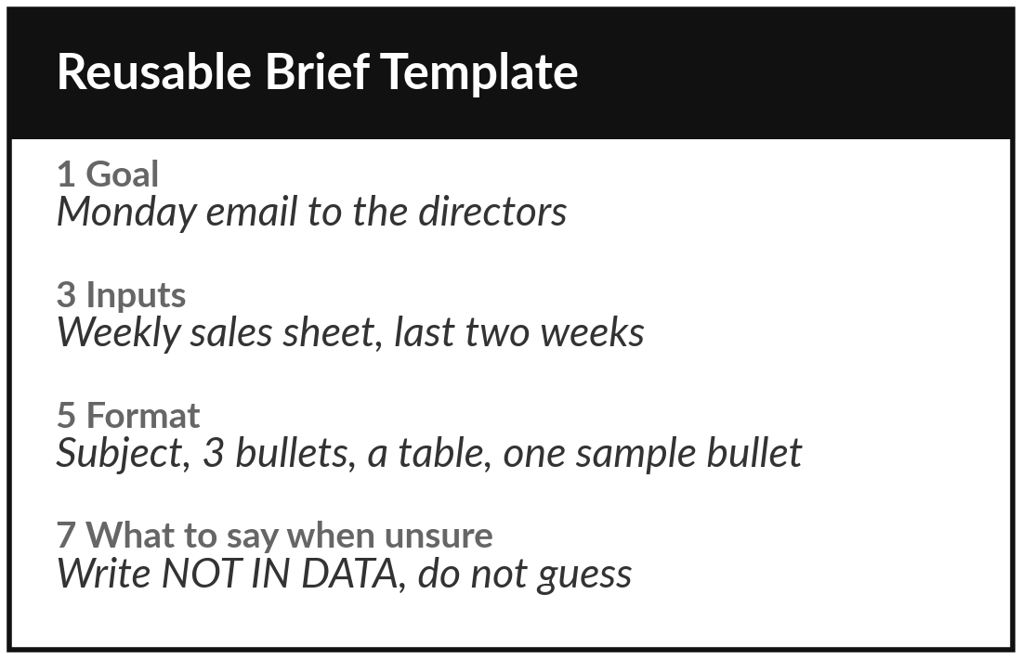
Practice: write the seven-part brief for your task
15 minutes
Your own company task
Write a reusable brief for your own task in the template.
Open the Reusable Brief Template.
Write all seven parts for your own task.
Part 5: add one example of a good answer.
Part 7: say what to write when unsure, from your Session 2 tests.
You keep: A complete seven-part brief, ready to paste.
Notes:
Take fifteen minutes. Open the Reusable Brief Template and write all seven parts for your own task. Name the goal and the reader. Say exactly what inputs the tool may use. In part five, fix the format and add one example of a good answer, made up or cleaned.
Write how you will check. For part seven, use the lesson from your own tests. If the tool invented a fact when you removed it, tell it to write NOT IN DATA and ask you. If it reworded a quote, tell it to quote word for word. I will walk round and read briefs with you.

Slide 16
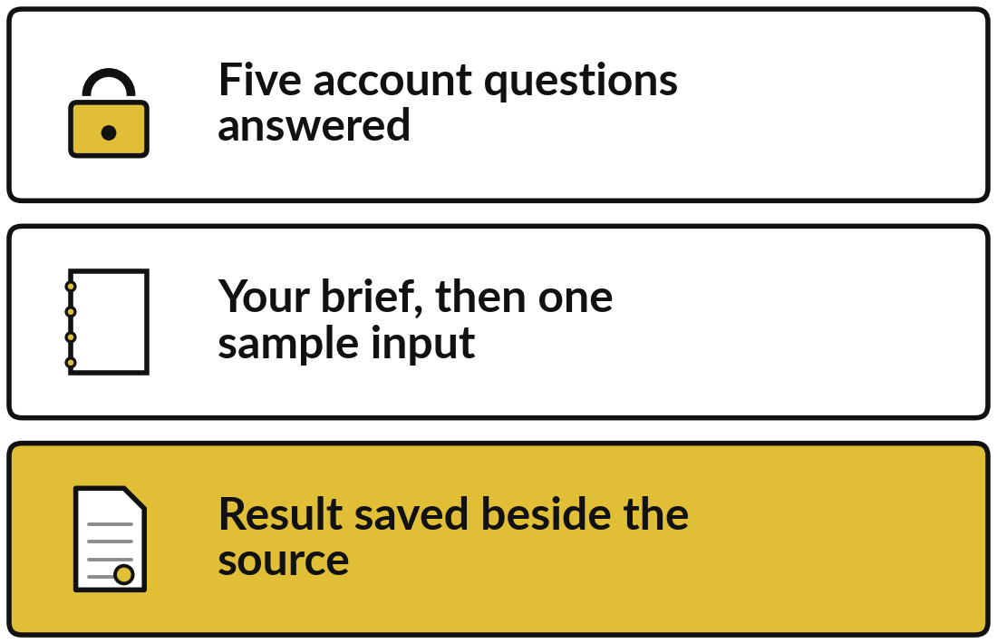
Practice: run the brief on a sample input
15 minutes
Your own company task
Answer the five account questions, then run your brief.
Answer the five account questions for your assistant.
Choose one sample input, with names, numbers and contacts removed.
Paste the brief, then the input. Answer any question it asks.
Save the result next to the brief.
You keep: Five account answers, and one result saved next to the source.
Notes:
Next fifteen minutes. First answer the five account questions for the assistant you will use. Find the answers in the account settings and terms, and write them in your workbook. If you cannot find an answer, that is a finding, and you use only invented text. Then choose one sample input from your task.
Until Session 4 that means no names, phone numbers, prices or contracts, and only a tool your company allows. Paste your brief and then the input. Read the answer fully and save it beside the source. We check first and change the brief afterwards.

Slide 17
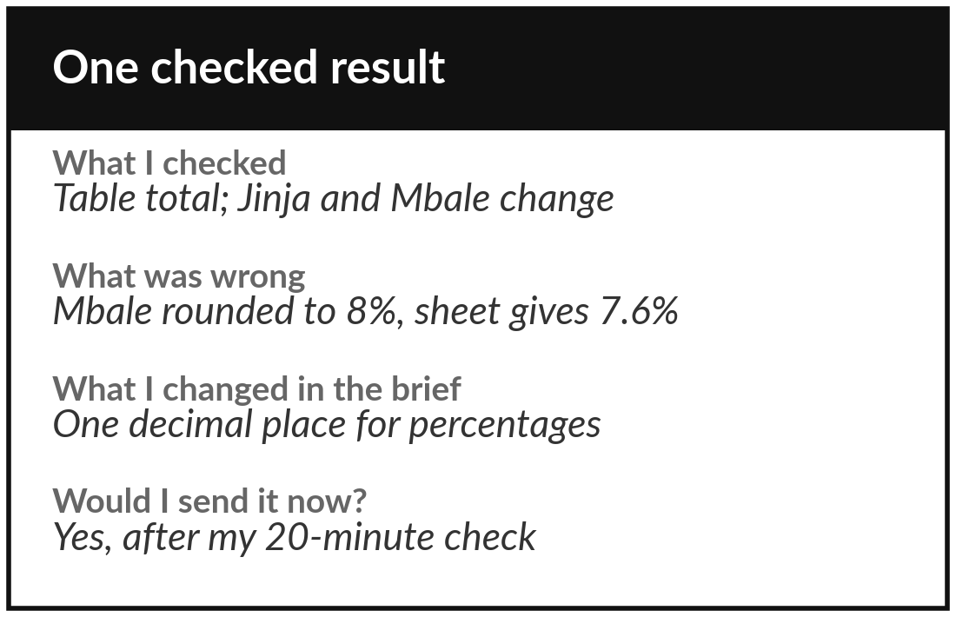
Practice: check the result against the source
15 minutes
Your own company task
Check your result and record what you found.
Compare each figure, name and date with the source.
Recompute one total or change yourself.
Write what was wrong and what the brief should say.
Update the brief and save the better version.
You keep: The brief plus one checked result, recorded in the template.
Notes:
The last fifteen minutes. Check your result against the source. Compare each figure, each name and each date. Recompute one total or one change yourself. Fill in the checked result section: date and tool used, what you checked, what was wrong, what you changed in the brief, and whether you would send it now.
If nothing was wrong, say how many items you checked. Then update the brief with the rule you learned, and save the improved version.

Slide 18



Decision: keep, change or stop?
After one checked result, what do you do with this brief?
Keep it
Change it
Stop for now
The result matched the source. Use it weekly with the same check.
Mistakes were fixable. Add rules, run it again next session.
Checking takes as long as doing it by hand. Pick another task or tool.
Write your choice, and the reason, on the template.
Notes:
Decision time. After one checked result, what do you do with your brief?
Keep it, because the result matched the source and you will use it weekly with the same check. Change it, because the mistakes were fixable and you will add rules and run it again. Or stop for now, because checking takes as long as doing the work by hand.
That last answer is valuable. It saves you from a poor automation later. Say your choice aloud, and then write it and the reason on the template.

Slide 19
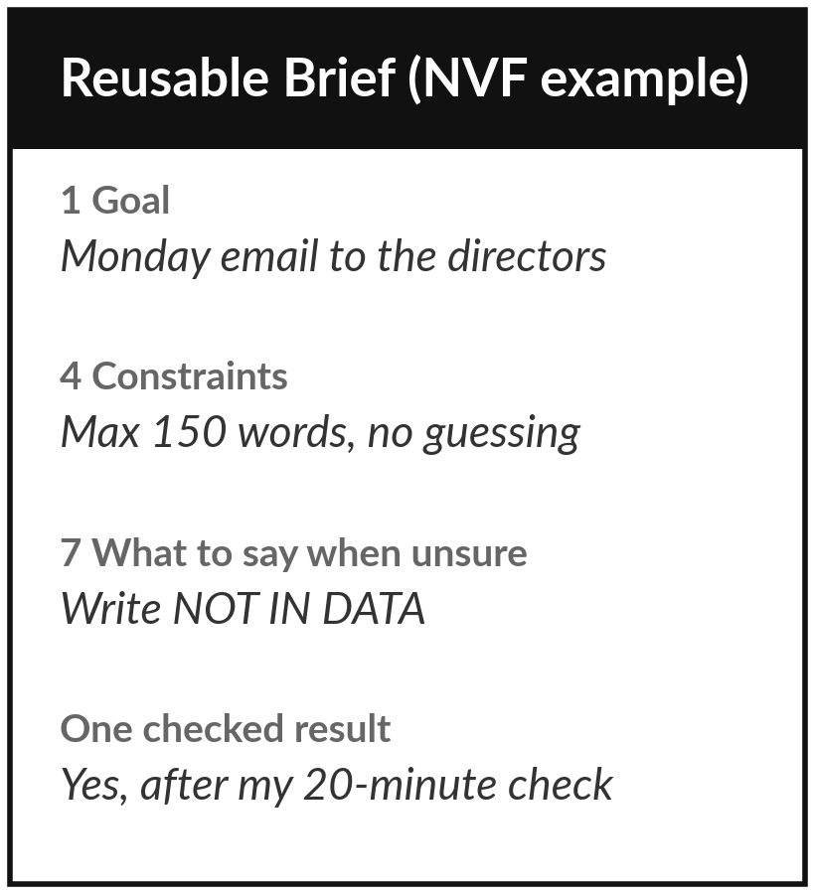
Save it, and keep it for the next session
What you keep from today
Your reusable brief and one checked result for your own task, saved in the Reusable Brief Template.
Our question today
How do I brief an AI tool and check what it returns?
Next session
Session 4: Your information. You will list what your company holds for your task and mark who may see it.
Notes:
Save the brief where you can paste it again, and keep the checked result next to it. In Session 4 we prepare the information that feeds part three of the brief. Optional before then: run the brief once more on a second sample at work and note anything it got wrong.
Until Session 4 the rule stays: no names, phone numbers, prices or contracts in a tool.
We began with this question: How do I brief an AI tool and check what it returns? Before you go, say in one sentence what you can now say about it.

